Slide 1
WELCOME

Slide 2
WELCOME

Slide 3
WELCOME
WELCOME

Slide 4
WELCOME

Slide 5
WELCOME

Slide 6
WELCOME
WELCOME

Slide 7
WEL

Slide 8
WELCOME

Slide 10
Management Compensation

Slide 11
Management Compensation

Slide 12

,
THE TEAM

Slide 13
,
THE TEAM
ANDRIAMAHERY
Miharintsoa Emmanuel
411002

Slide 14

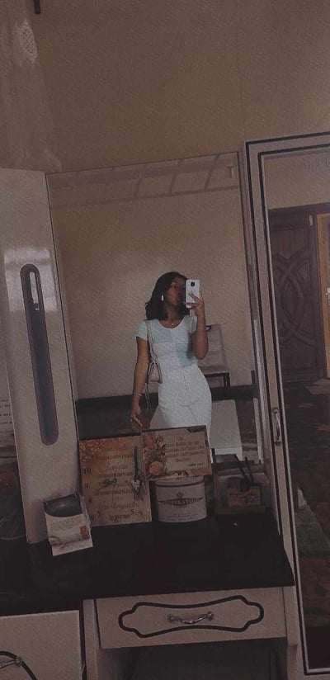
,
THE TEAM

Slide 15
,
THE TEAM
RAMANAMISATA Nirina Tantely
412076

Slide 16

,
THE TEAM

Slide 17
,
THE TEAM
RAMANANTSITOHARA Miahy Naelle Ouliannah
413118

Slide 18

,
THE TEAM

Slide 19
,
THE TEAM
RALISON
Anna
412074

Slide 20
The process of managing, analysingn and determining the salaryn incentives, and benefits each employee receives. Compensation management is a crucial part of any talent management and retention strategy

Slide 21
DEFINITION
The process of managing, analysing and determining the salary incentives, and benefits each employee receives.
depending on the legal form of the company and the status of the manager

Slide 22
Base salary
Incentive pay, with a short-term focus, usually in the form of a bonus
Incentive pay, with a long-term focus, usually in some combination of stock awards, option awards, non-equity incentive plan compensation
Enhanced benefits package that usually includes a Supplemental Executive Retirement Plan (SERP)
Extra benefits and perquisites, such as cars and club memberships
Deferred compensation earnings

Slide 23
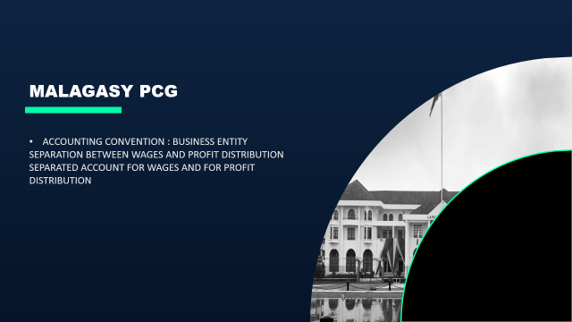
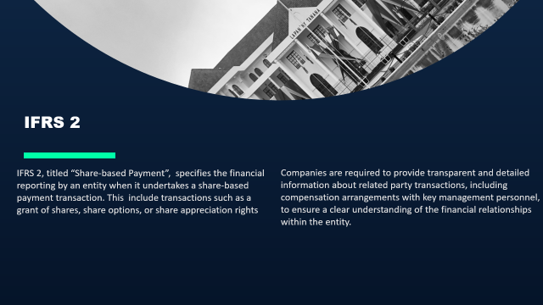
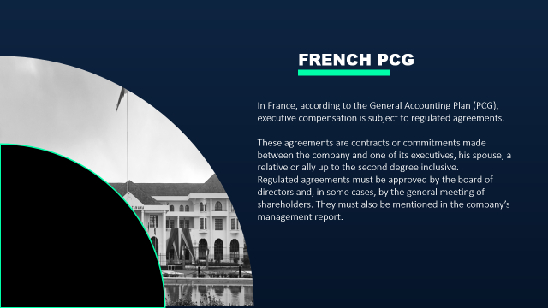

Slide 24
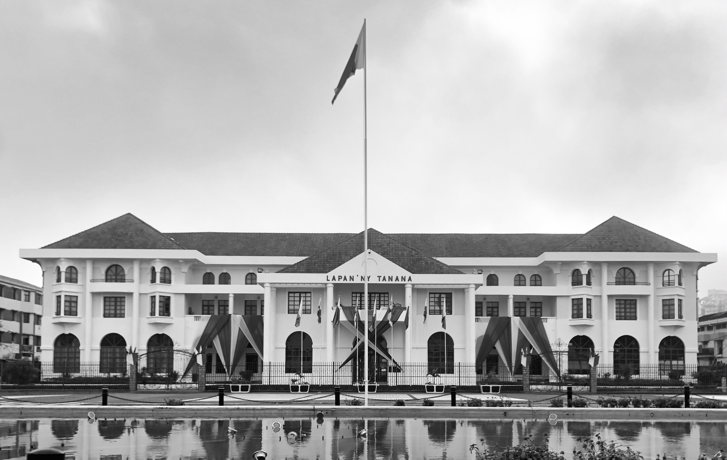
MALAGASY PCG
ACCOUNTING CONVENTION : BUSINESS ENTITY
SEPARATION BETWEEN WAGES AND PROFIT DISTRIBUTION
SEPARATED ACCOUNT FOR WAGES AND FOR PROFIT DISTRIBUTION

Slide 25
FRENCH PCG
In France, according to the General Accounting Plan (PCG), executive compensation is subject to regulated agreements.
These agreements are contracts or commitments made between the company and one of its executives, his spouse, a relative or ally up to the second degree inclusive.
Regulated agreements must be approved by the board of directors and, in some cases, by the general meeting of shareholders. They must also be mentioned in the company’s management report.

Slide 26
IFRS 2
IFRS 2, titled “Share-based Payment”, specifies the financial reporting by an entity when it undertakes a share-based payment transaction. This include transactions such as a grant of shares, share options, or share appreciation rights
Companies are required to provide transparent and detailed information about related party transactions, including compensation arrangements with key management personnel, to ensure a clear understanding of the financial relationships within the entity.

Slide 27
THE DIFFERENT KIND OF PEOPE IN THE COMPANY
SHAREHOLDERS/OWNERS: to put their money in the corporation.
PROFIT DISTRIBUTION
DIRECTORS/OWNERS REPRESENTATIVE: to work in the name of the owners and in the running of the company.
PROFIT DISTRIBUTION / WAGES
OFFICERS/ EMPLOYEES: to work for the company.
WAGES / SALARY

Slide 28
Public Limited Company SA
Limited Liability Company SARL
02
01
Management compensation depends on the legal form of the company and the status of the manager
03
Partnerships SNC

Slide 29
Public Limited Company SA
Limited Liability Company SARL
01
02
03
Partnerships SNC

Slide 30
How to compensate executives there?
wages
Attendance fees
wages of the chairman, board members who are executives in the company
Employer social contribution
Payment assigned to the members of the board attending for the Board meeting
independent of operating incomes and are paid even in the absence of profits

Slide 31
Accounting records
WAGES
644 XXX (Gross salary)
431 XXX (employee social contribution for CNaPS)
432 XXX (employee social contribution for OSTIE)
44X XXX (income tax)
425 XXX (salary advances)
421 XXX (employee acc payable – net salary)
(WAGES)

Slide 32
Accounting records
WAGES : Employer social contribution and payment
645 XXX
431 XXX (Employer social contribution for CNaPS)
432 XXX (Employer social contribution for OSTIE)
421 XXX (net salary)
431 XXX (CNaPS)
432 XXX (OSTIE)
512/53 XXX(payment)

Slide 33
Accounting records
ATTENDANCE FEES
653 Attendance fees expenses XXX
455 shareholder current account XXX

Slide 34
02
Limited Liability Company
(Société A Responsabilité Limitée)

Slide 35

What is the status of the manager ?
Executives holding the majority of shares (+ 50% of share capital/Voting power)
Executives holding the minority of shares (- or = 50% of share capital/Voting power)

Slide 36
For the executives holding the minority of power
Monthly Wages
644 XXX (GROSS SALARY)
431 XXX (CNAPS)
432 XXX (OSTIE)
44X XXX (INCOME TAX)
425 XXX (ADVANCES)
421 XXX (NET SALARY)
Employer monthly contribution
645 XXX (Employer contributions)
431 XXX (CNAPS)
432 XXX (OSTIE)

Slide 37
For the executives holding the minority of power
Payment
421 XXX (net salary)
431 XXX (cnaps)
432 XXX (ostie)
512/53 XXX

Slide 38
For the executive holding the majority of power
Profit distribution:
455 XXX (net of income tax payment)
512/53 XXX (net of income tax payment)
(Payment occurring during the year)
12 /63X XXX (income tax)
444 XXX (income tax)
(Tax on dividend)
12 XXX
455 XXX
(End of the year - Regularization)

Slide 39
03
Partnerships
(Société en Nom Collectif)

Slide 40
COMPENSATION OF THE EXECUTIVES
455 XXX (net of income tax payment)
512/53 XXX (net of income tax payment)
(Payment occurring during the year)
12 /63X XXX (income tax)
444 XXX (income tax)
(Tax on dividend)
12 XXX
455 XXX
(End of the year - Regularization)

Slide 41
APPLICATION
MANDROSO is a limited liability company with MGA de 45 000 000 share capital (3000 shares for MGA nominal value of 15000 each). The shareholders are : Rabe (1600 shares), Rakoto (700 shares), Rasoa (700 shares)
The General Manager receive monthly MGA 19 000 000 Gross salary
It was planned that each shareholder will take over as the General Manager each year.
The first year is the turn of Rakoto, the second year is the turn of Rabe and the third year is the turn of Rasoa.
Work to be done : Recording of the annual executive’s pay in the bookkeeping of the company MANDROSO

Slide 44
APPLICATION
MANDROSO is a limited liability company with MGA de 45 000 000 share capital (3000 shares for MGA nominal value of 15000 each). The shareholders are : Rabe (1600 shares), Rakoto (700 shares), Rasoa (700 shares)
The General Manager receive monthly MGA 19 000 000 Gross salary
It was planned that each shareholder will take over as the General Manager each year.
The first year is the turn of Rakoto, the second year is the turn of Rabe and the third year is the turn of Rasoa.
Work to be done : Recording of the annual executive’s pay in the bookkeeping of the company MANDROSO

Slide 47
Management Compensation

Slide 48
THANKS

